Slide 1

A Beginner's Guide: Maintaining Historic Buildings

Slide 2
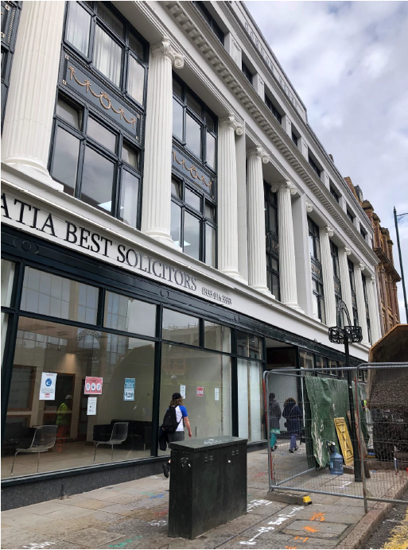
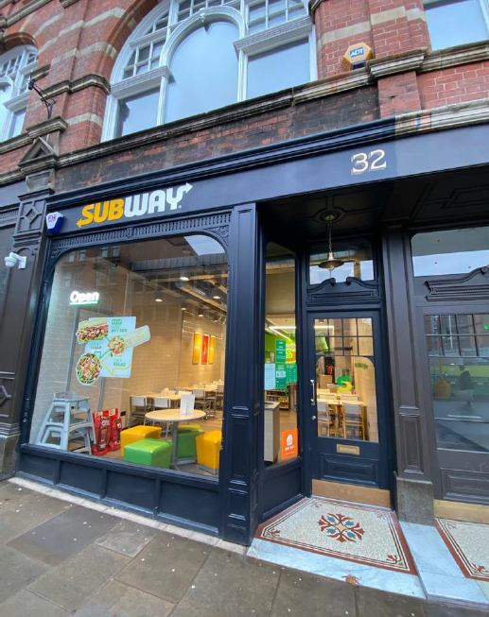
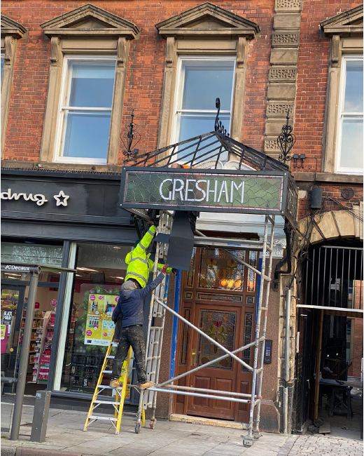
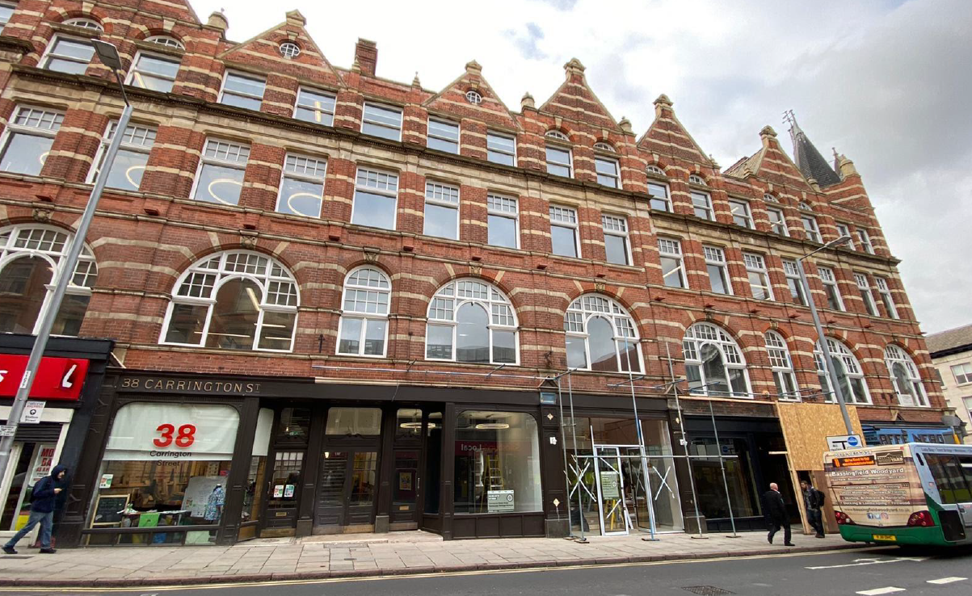



The Carrington Townscape Heritage project

Slide 3

Clicking this will change your view.
You can ask questions at any point using this function
You can mute yourself and stop your video using these icons
I may also sometimes ask you to give me a thumbs up or reaction, you can find those here
Notes:
Default on mute so that everyone can hear well. Also happy for people to stop their videos at any point.
If you can’t see me try the view change
Reactions – especially if your camera is off.
Chat function – ask questions as we go. I’ll keep an eye on them and answer at the end of a slide/topic or at the end if more appropriate.

Slide 4

Programme for the day
Welcome
Aims of this Session
Spot the Fault – The First Attempt
The Most Common Faults in Historic Buildings
Break
Spot the Fault – The Second Attempt
Maintenance Matters
Surveying Your Building
Lunch
Planning Your Maintenance and Monitoring Your Building
Evaluation, Questions and Close

Slide 5
By the end of the session you will be able to:
Identify common faults and when you should get more help
Identify key annual tasks and checks which should be undertaken as part of maintaining your building
Carry out a rapid condition survey on your building and identify actions that need performing or where you need to get some help
Understand when maintenance becomes work that may require permission on listed properties or in conservation areas

Slide 6

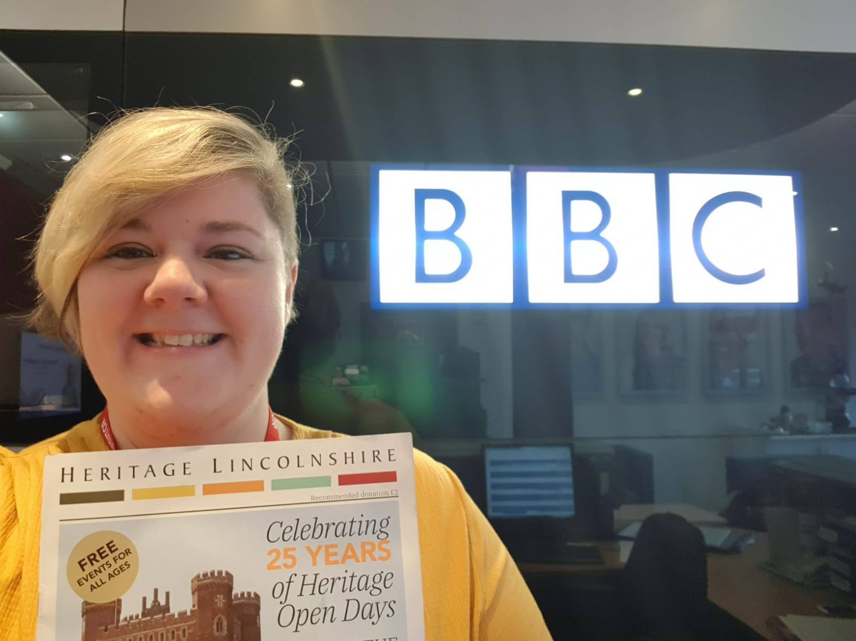
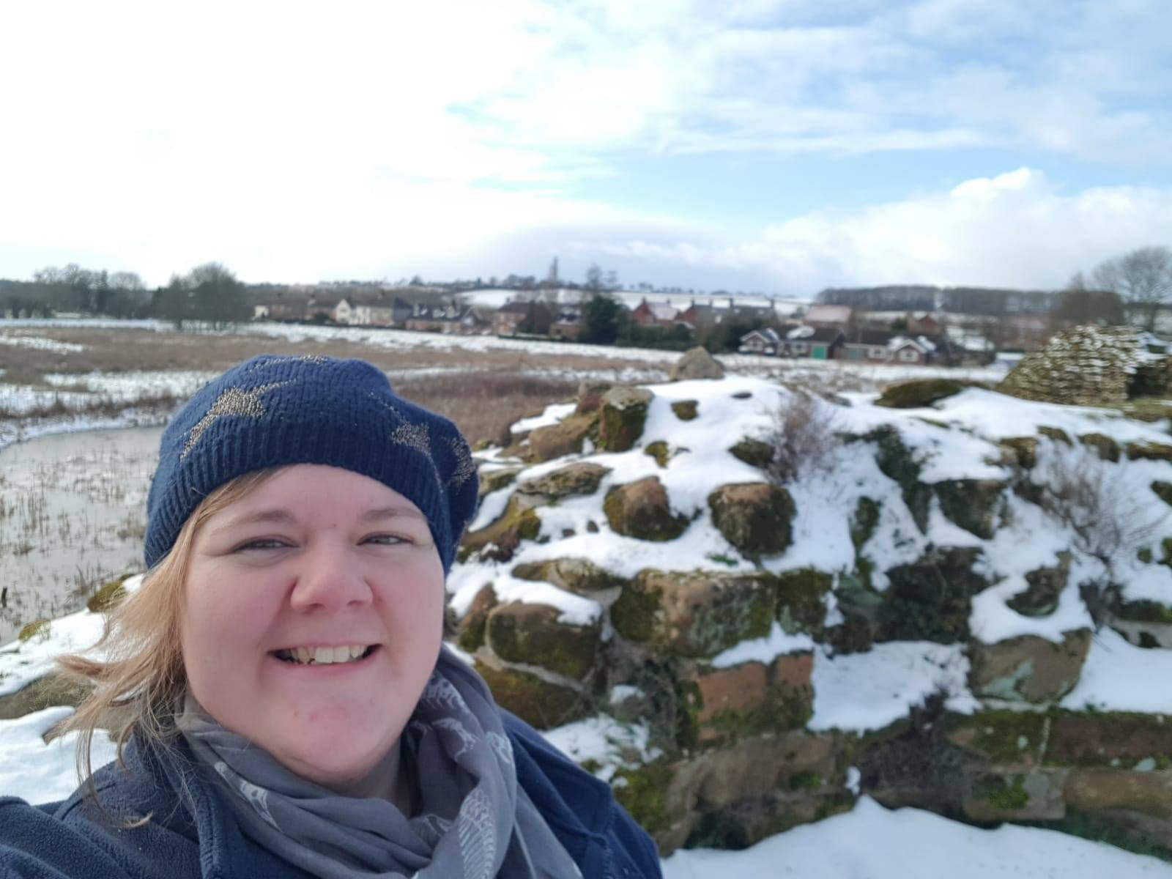
Charlotte
Sites Manager & Heritage Open Days Co-Ordinator, Heritage Lincolnshire
Notes:
Me intro – not an architectural historian etc. Member

Slide 7
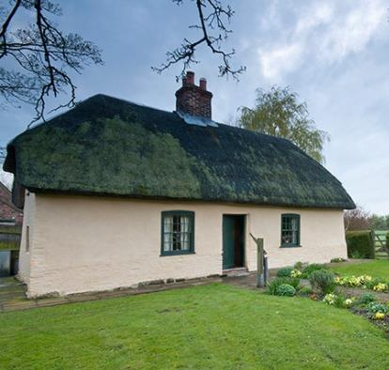
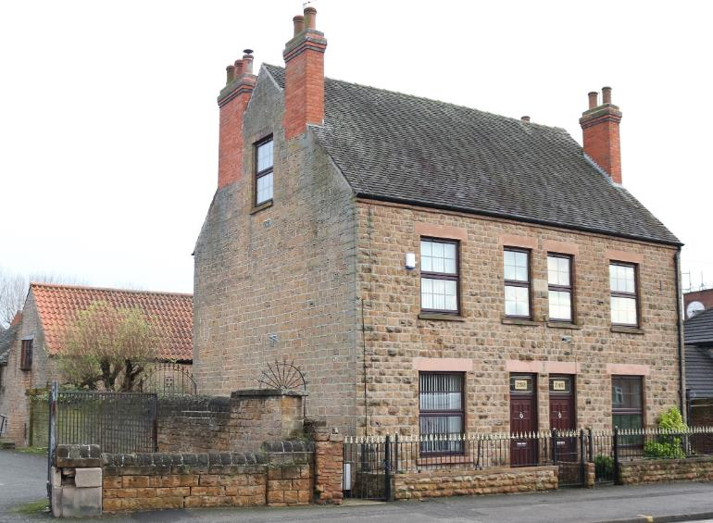
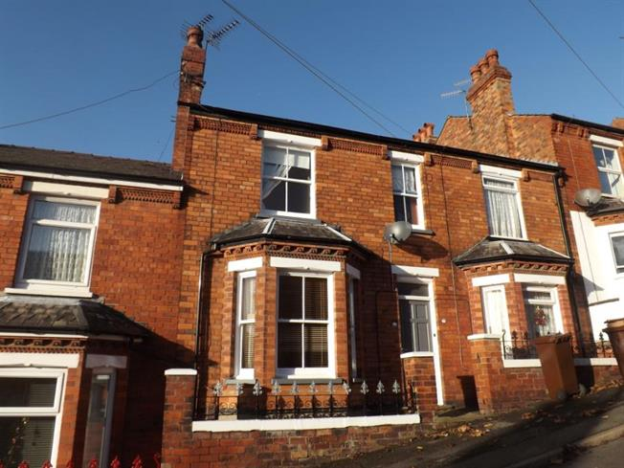
Notes:
For the purposes of today, when we talk about historic buildings I am thinking mostly of pre-1919, solid wall construction. These are made traditionally of natural, porous materials which can let moisture into buildings but, crucially, encourage moisture back out of the building again. These include materials such as brick (lower fired and no chemical additives), sedimentary stones, LIME, timber etc. Flexible and breathable.
We want to avoid excess moisture at all costs – and that really will come through strongly! These principles also do apply for a home built in the last century.

Slide 8
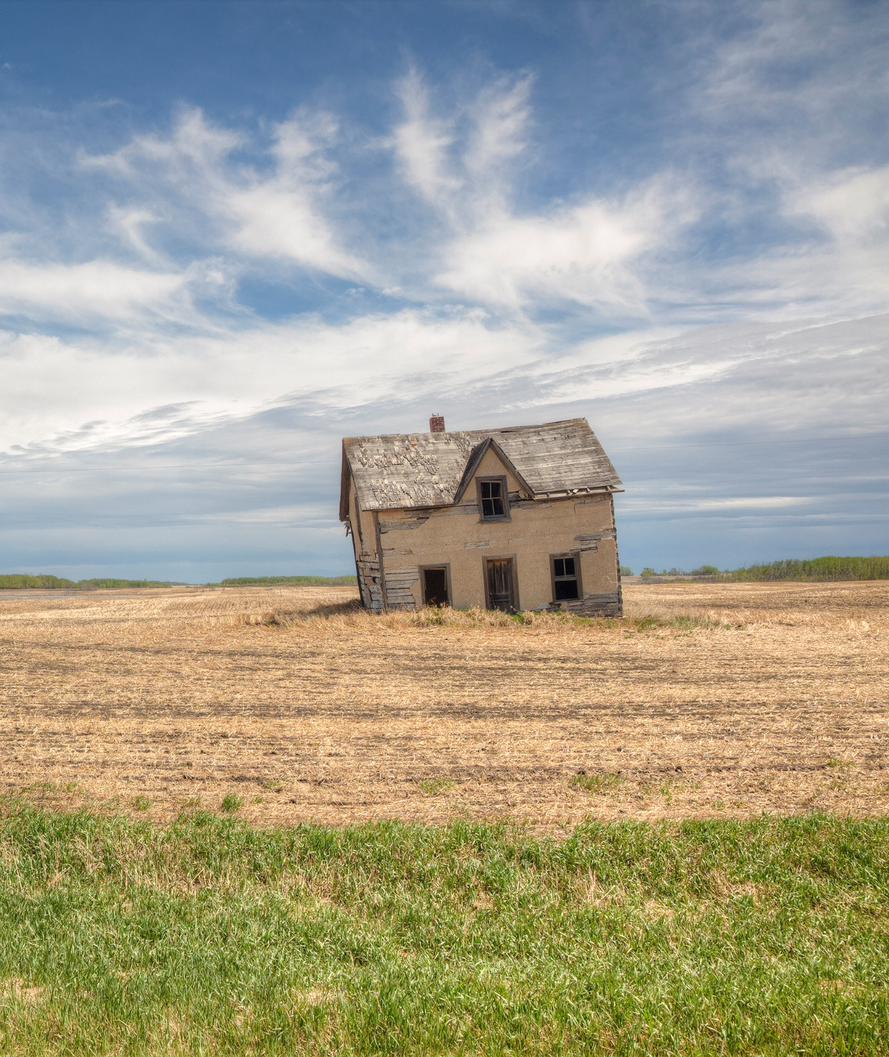
The Most Common Faults in Historic Buildings

Slide 9
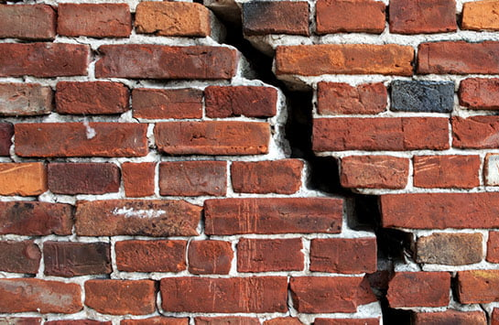
Spot the fault!

Slide 10
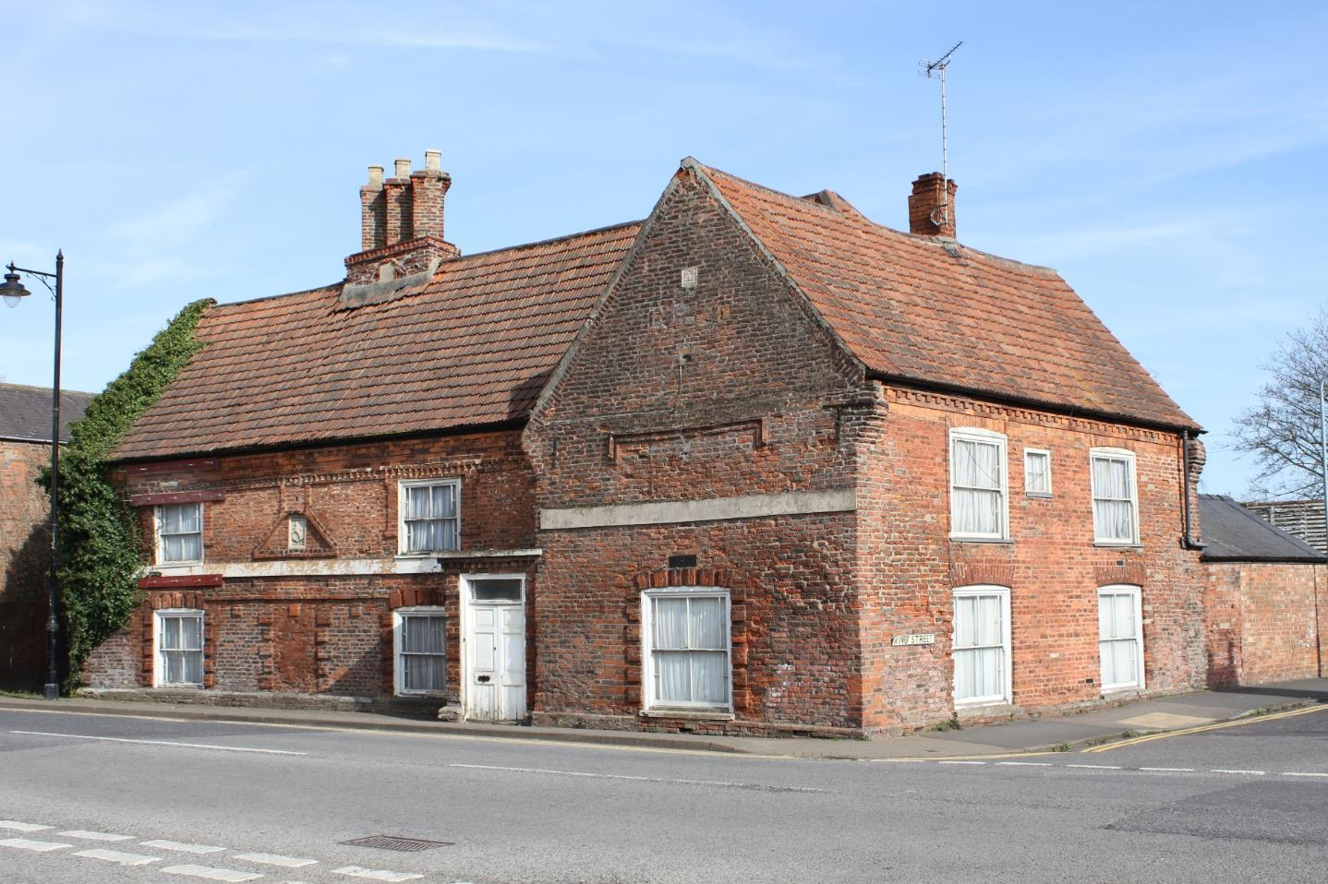

Slide 11
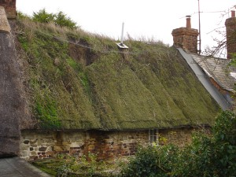

Slide 12
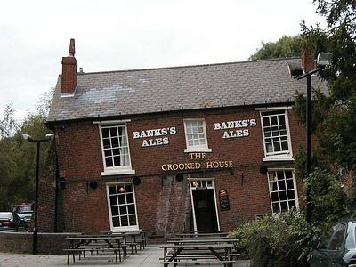
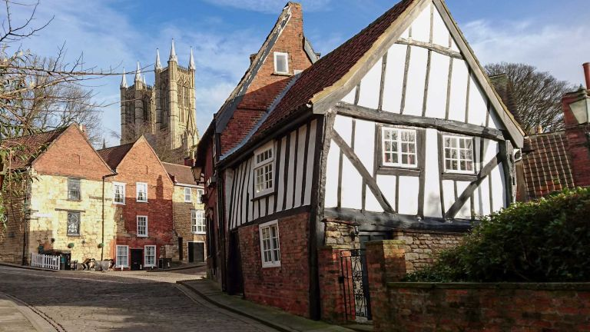

Slide 13
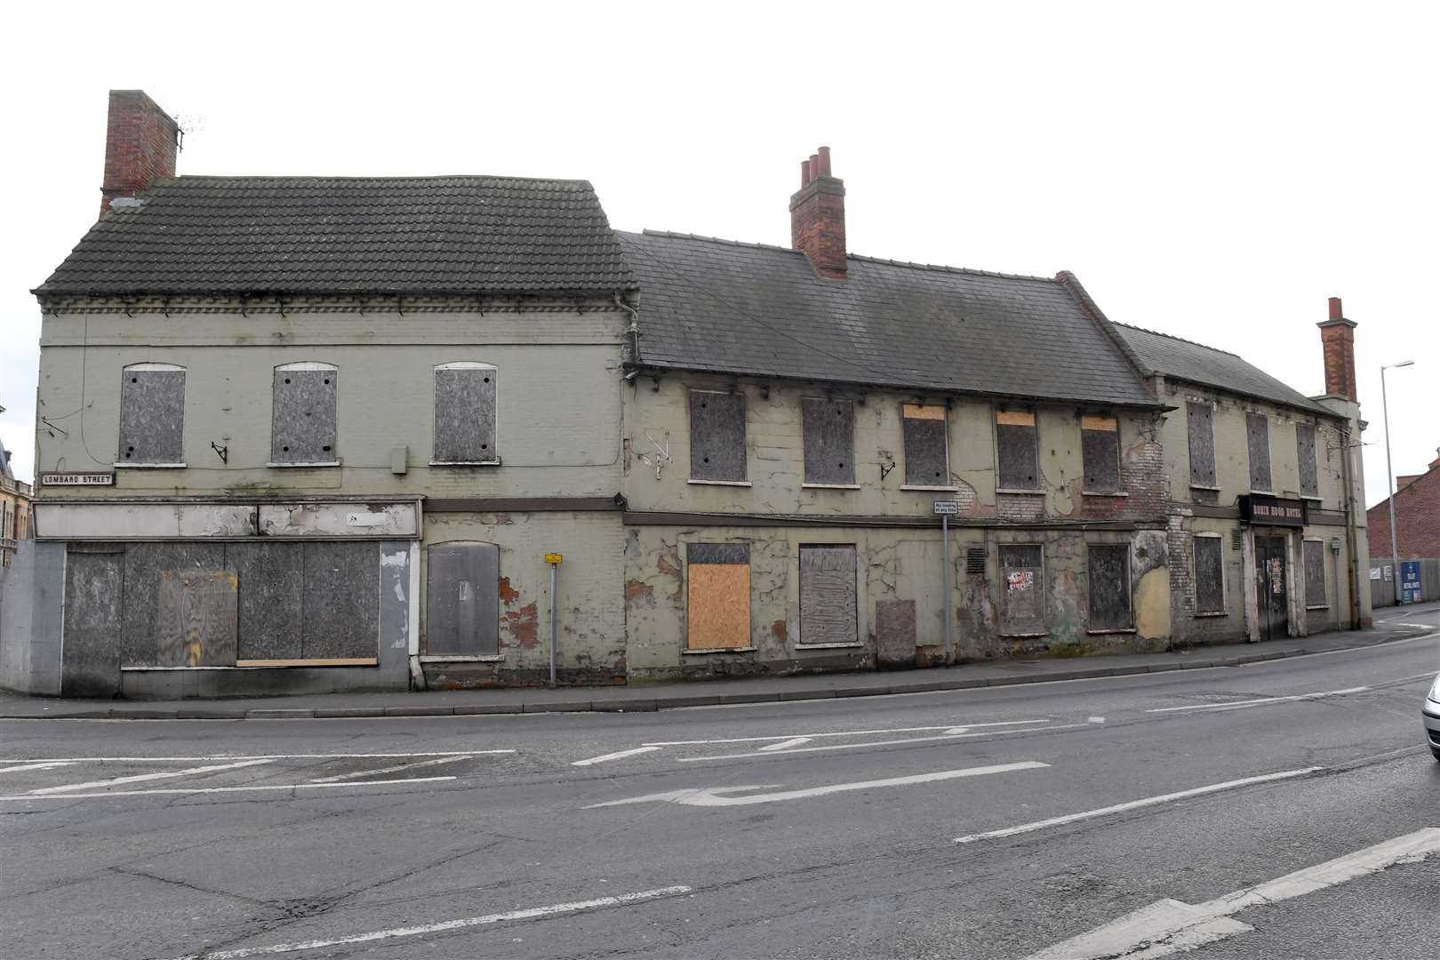

Slide 15
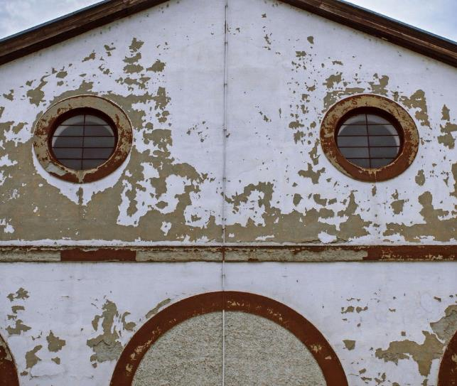
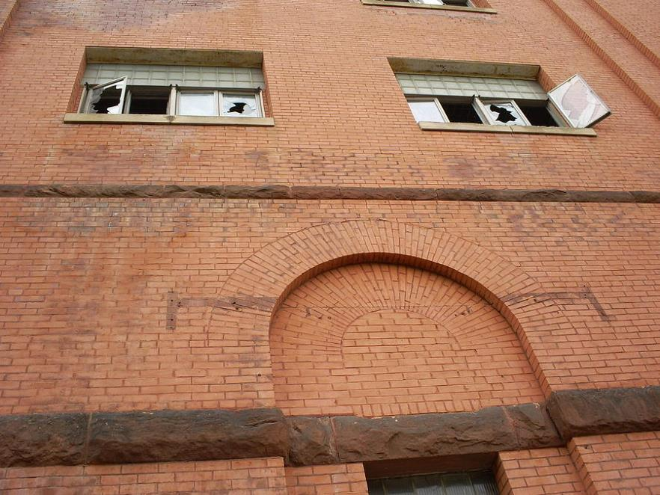
What can go wrong?

Slide 16
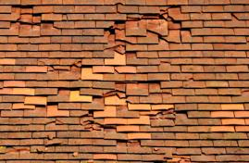
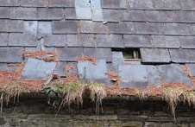
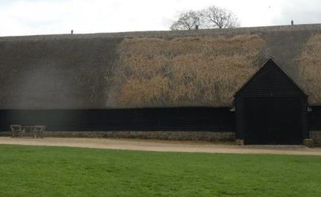
Roof
Tiles can slip or get broken
Thatching can begin to rot or get damaged

Slide 17
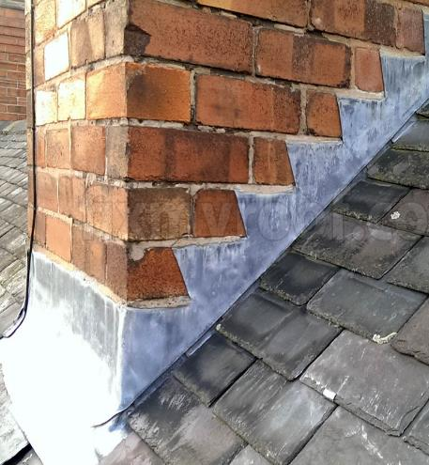
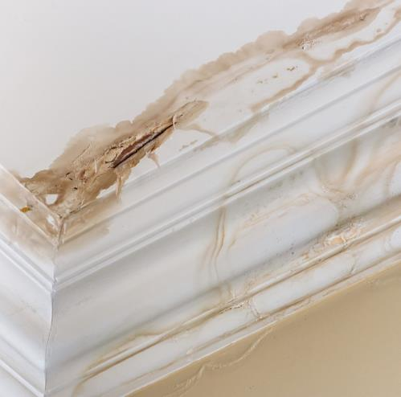
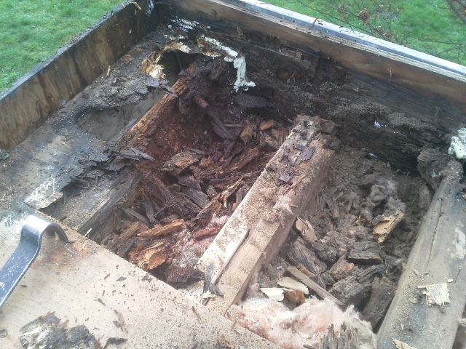
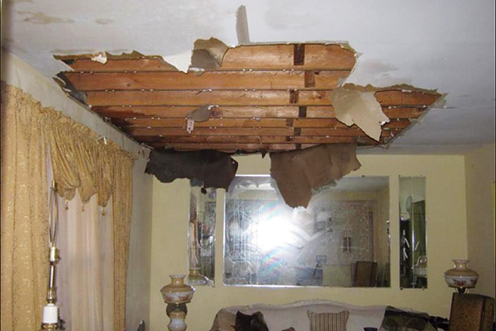
Roof
Flashing around chimneys can become damaged or can split
Lead can become fatigued or can even be stolen
Notes:
Once moisture gets in it can introduce rot and pests to the structural timbers
Moisture can start to rot and compromise the strength of roof elements such as beam, lathes etc.

Slide 18
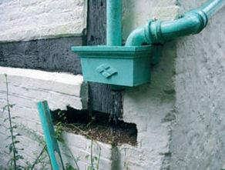
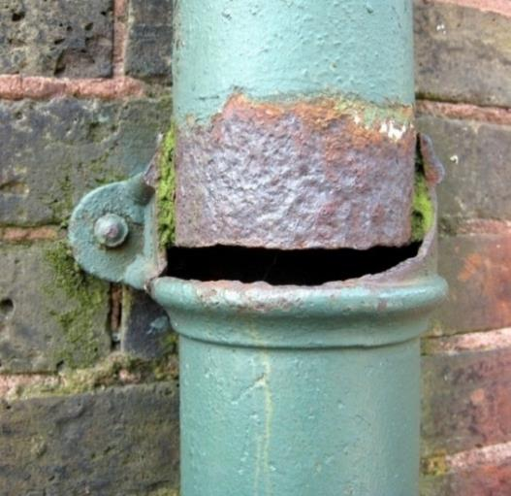
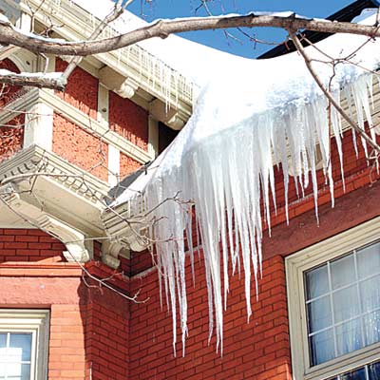
Rainwater goods
Can split or break in bad weather

Slide 19
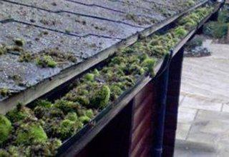
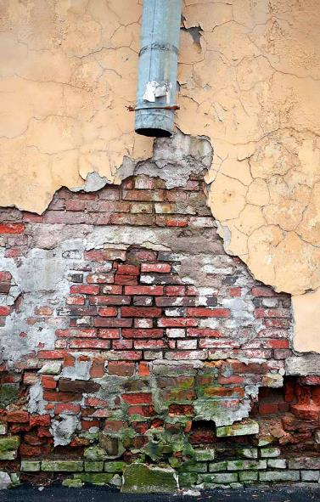
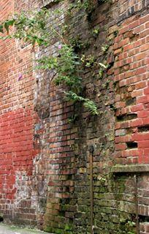
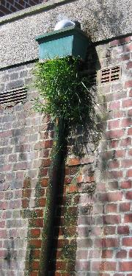
Rainwater goods
Can become blocked with vegetation, nests or ice
If not maintained or fitted correctly it can direct water onto the building
Notes:
Cause leaks
Damp in walls and roof spaces

Slide 20
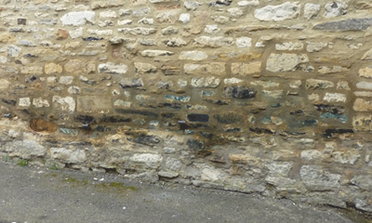
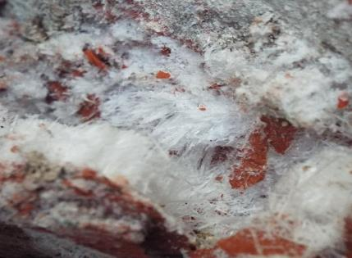
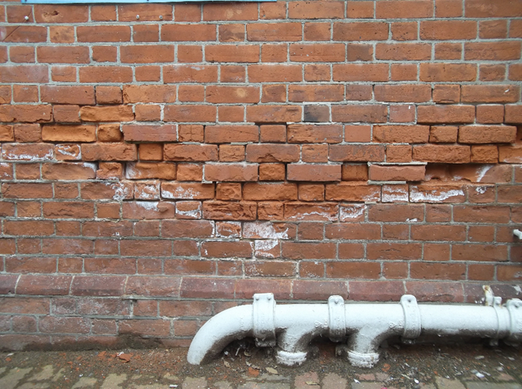
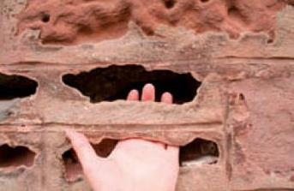
Walls
Inappropriate materials can cause decay
Moisture can get into walls and cause issues with frost and salt movement

Slide 21
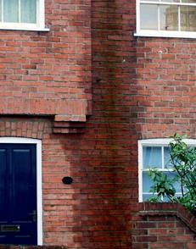
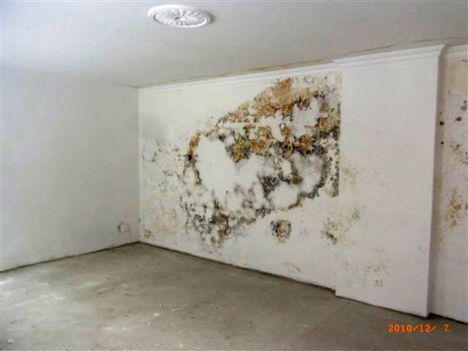
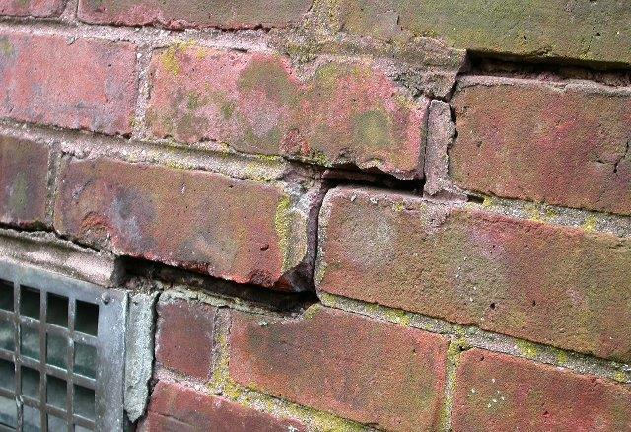
Walls
Damp can penetrate from the base of the wall, sides or the top
Movement can cause walls to fail
Most issues are due to something else failing

Slide 22
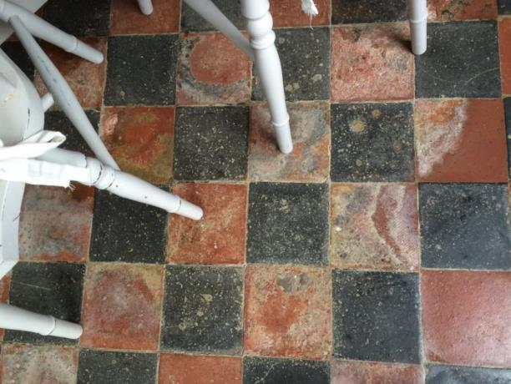
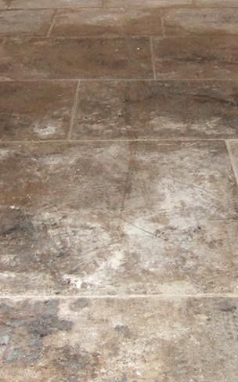
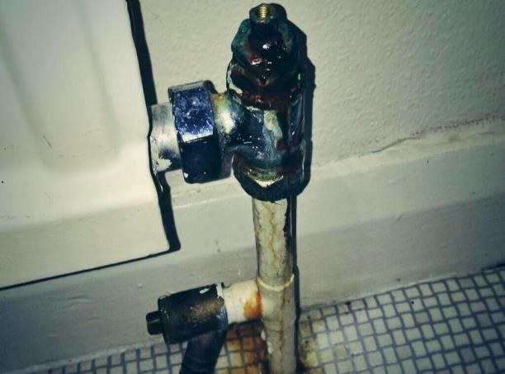
Floors
Moisture can penetrate from the ground or from the walls
Leaks from interior items such as boilers or radiators can cause damage

Slide 23
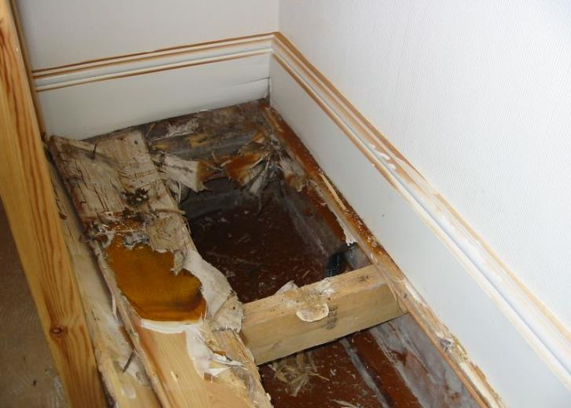
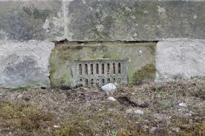
Floors
Spaces between floors may not be well ventilated encouraging mould growth, rot and pests

Slide 24
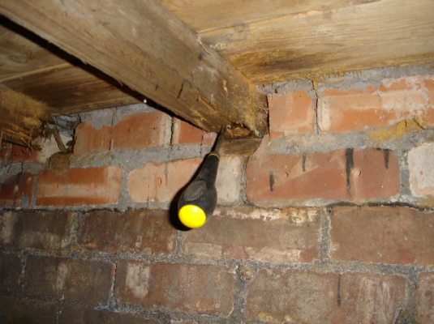
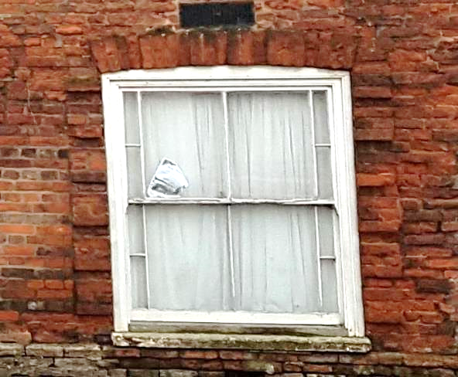
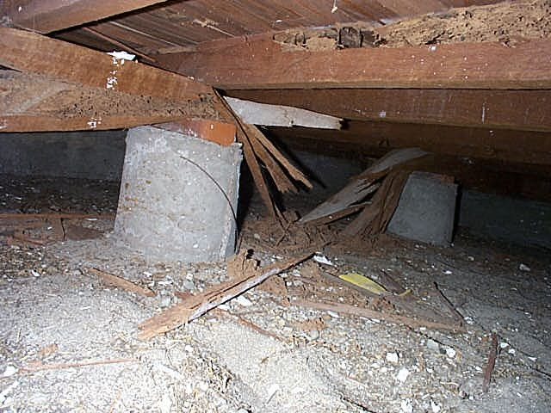
Timber
Excess moisture weakens timber and makes it vulnerable to rot
Can be due to condensation or leaks
Damp timber can attract pests
Decaying windows can become unsafe
Notes:
All rot requires moisture
Insects cannot attack dry, heart wood.

Slide 25
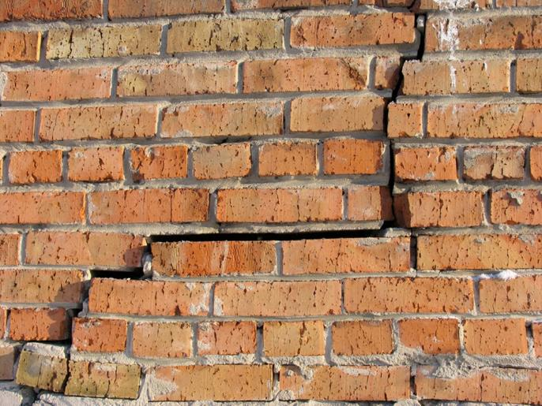
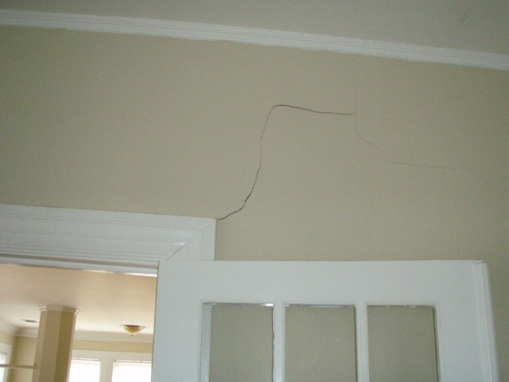
Foundations
Can be affected by water, ice, ground movements
Movement of water can affect the stability of the ground foundations are built on
Sometimes no foundations are present!

Slide 26
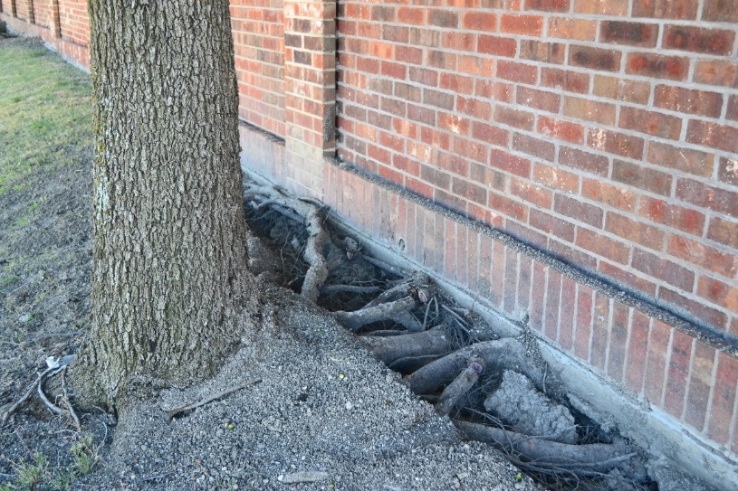

Foundations
Vegetation can also effect the ground
Subsidence can cause cracks in walls and foundations
Movement may be historic
Notes:
When did it happen?

Slide 27


Poor Maintenance can lead to big problems
Notes:
Again – water management is key!!

Slide 28

Break
10 Minutes

Slide 29
Spot the fault!

Slide 35
Regular Maintenance

Slide 36


Check roofs for frost snow or wind damage. Look for debris on the ground that may indicate slipped slates or tiles.
Inspect lead flashings and mortar fillets around chimneys for holes or splits, or erosion of mortar.
Notes:
Question – so if we are thinking about general maintenance – what tasks do you think we need to be doing, checks etc?
8 things on this slide – then ask about timings

Slide 37


Check for splits or cracks in areas of flat roofing. (Or missing lead!)
If you can access your roof space safely, check for signs of leaks or damage during or just after heavy rain.
Notes:
Question – so if we are thinking about general maintenance – what tasks do you think we need to be doing, checks etc?
8 things on this slide – then ask about timings

Slide 38



Check gutters are clear of leaves, debris, snow etc. and clear if safe. Don’t forget your valley gutters!

Slide 39


Check that eves and gutters have not been damaged by water, snow or ice. Note areas with cracks and arrange for repairs.
Check drains and gulleys beneath rainwater goods are clear. If they are blocked clean out.
Notes:
Use of a ladle!

Slide 40




Check masonry for signs of damage. Check mortar for eroded joints, cracks or signs of movement.
Notes:
Mention cement renders

Slide 41


Check that all external timber work is in a good state of repair, repaint where required and look for signs of rot.
Check that windows and vents can be opened to allow for ventilation on dry days. Lubricate door and window ironmongery if required.
Notes:
Check that windows are in good state of repair, including; the glazing, putty and any lead work. Arrange for repair if needed.

Slide 42


Clear away plant growth from the base of walls and drainage channels.
Make sure airbricks or under floor ventilators are free from obstruction and clean/clear them if necessary.

Slide 43


Have your electrical, gas and other heating systems checked regularly (at least every five years) by a qualified person.
Get your heating system checked and bleed your radiators.

Slide 44

Surveying your building
Notes:
You will need – camera, binoculars, something to take notes with, appropriate attire (will you be trudging through flower beds?)

Slide 45


Health & Safety
Surveying at height or in small spaces
Notes:
Always think about your safety first – this can often go out of our heads, especially when in our own homes!
If you are checking roofs/gutters think about your access. If using ladders they should be correctly supported and may require footing if they are not self-supporting. Even if access is safe on your own, make sure someone knows what you are doing and how long you expect to be doing the task for. If possible take a phone or something in your pocket for emergencies.
Same goes for crawl spaces, lofts or basement with difficult access.

Slide 46


Health & Safety
Common hazards: Structural
Notes:
Other hazards to consider:
Structural – can floors/surfaces bear your weight? Especially if you are inspecting areas of suspended ceilings, flat roofs etc.

Slide 47

Health & Safety
Common hazards: Animal waste/pests
Notes:
Animal waste/pests – consider PPE (gloves, goggles, mask & wash hands afterwards) – this is in a church tower – nesting material will inc droppings
Also moulds and fungi – careful if you have any sensitivities.

Slide 48


Health & Safety
Common hazards: Broken material
Notes:
Broken materials – slate, glass etc. especially in gutters, gullies and drains

Slide 49


Health & Safety
Common hazards: awareness of surroundings
Notes:
Vehicles/trips and falls while looking up and not around you as much! Outside, but also inside in low light

Slide 50

Health & Safety
Common hazards: old services
Notes:
Be aware of older services, particularly exposed electrics etc. if your building hasn’t been updated.

Slide 51

Chimneys
Roof
Rainwater goods
Walls
Windows & Doors
Airbricks/vents
Ground surfaces
Drainage

Slide 52

Attic space
External walls
Internal walls
Floors
Basement
Services
Notes:
Pay particular attention to areas where you have spotted faults externally.
Take photographs as you go and save these with the date marked – you can then use these in the future to compare – especially where you have structural cracking…
To plan and remind yourself of maintenance tasks, try and get them in your diary and/or look at resources from SPAB which are geared toward churches but very easily adaptable. We are just at the end of national maintenance week which encourages a lot of that kind of work around this time each year.

Slide 53


Monitoring Cracks
Notes:
Small cracks may be seasonal movement or historic – monitoring can help determine this. You can use tell tales, commonly seen, especially for vertical cracks. Structural engineers I’ve worked with have preferred the use of disks which you can also put in 3 positions to better monitor diagonal cracks. Monthly readings BUT if at any time you are worried, contact a CARE engineer. (Conservation Accreditation Register of Engineers)

Slide 54

Lunch
45 minutes

Slide 55
Maintenance Schedule and Inspection Exercise

Slide 56

20 Minutes

Slide 57
Discussion

Slide 58
Break
10 Minutes

Slide 59


Conservation & Maintenance
Maintenance or like for like repair
Demolition or partial demolition
Effect of the special character of the building
They have powers to take action
Notes:
Conservation officers and planners with heritage responsibilities are not out to make your life difficult – they are out to protect buildings and ultimately this will protect your investment! They want to work with you and will give you the best advice they can. They’ve been subject to huge cuts – often in a local authority there may not even be one full time person dealing with conservation for the whole area.
They are following legislation such as: Town and County Planning Act, Listed building and conservation areas act, Enterprise and regulatory reform act; using guidance from the NPPF – they have to follow due process in making decisions about what does and does not require consent – particularly where demolition or partial demolition is involved. Anything that effects the special character of a building requires permission. So, like for like repairs are unlikely to need permission, but may require a conversation so that they are happy about the materials being used. There is a certain amount of personal judgement, but that is governed by professional standards (IHBC, BS)
(As a charity you may find that you can get a certain amount of advice for free before you apply for listed building consent/planning permission, but this will be heavily caveated on needing to see full designs/a conservation plan. Pre application enquiry exists – often with a fee – and allows you to run through what you are looking at doing and get a formal opinion on your works. Listed building consent then has a timescale (8 weeks for Grade II or 12 weeks for Grade II* or I). Listed buildings and planning permission for relevant demolition in a conservation area, no application fee is required. Work must begin within 3 years of consent.)
They make a lot of decisions based on how what you want to do will alter the significance or ‘special character’ of the building explain – meaning they need to understand what you have before the can make decisions. The better they understand what you’ve got, the more they will be able to work with you in decisions

Slide 60
Further resources
National Heritage Training Group – http://www.the-nhtg.org.uk/ - Network for information on courses, contractors and funders
Society for the Protection of Ancient Buildings - http://www.spab.org.uk/ - General information for homeowners and guides which can be purchased
Responsible retrofit wheel - http://responsible-retrofit.org/wheel/ - Brilliant tool for seeing what different interventions will do to your building
Historic Scotland - http://www.historic-scotland.gov.uk/freepublications - Fantastic set of free publications and guides to living in/owning historic buildings
English Heritage – http://www.english-heritageshop.org.uk - Practical Building Conservation Series. Not cheap but exhaustive directory of all things conservation
Historic England – http://www.historicengland.org.uk - Advice and technical guidance for listed building owners and information on planning guidelines
Listed Property Owners Club - www.lpoc.co.uk - Membership group with advice for owners of listed buildings
Building Conservation website – www.buildingconservation.com - Articles and books as well as a directory of professionals. Also information on courses and qualifications

Slide 61


Evaluation
https://www.heritagelincolnshire.org/carrington-st-area-thi-evaluation-form

